Slide 1
Valence and Arousal
Estimation for
Video Events
Giulia Bertazzini
Niccolò Guiducci
Firenze, 7 Aprile 2023

Slide 2
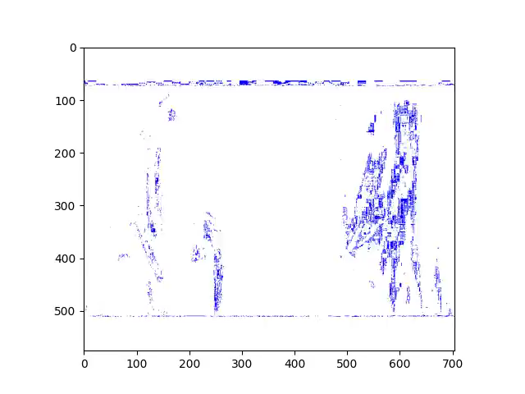

Goals
Generate video events from RGB videos, labeled with valence and arousal
Estimate valence and arousal values on video events

Slide 3
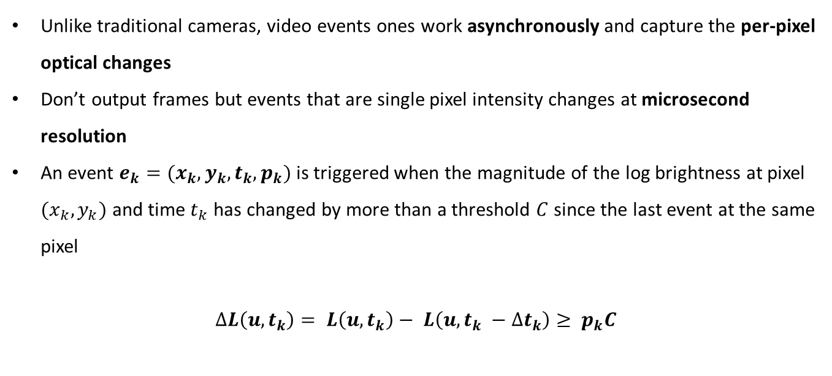
Introduction
Video Events
Unlike traditional cameras, video events ones work asynchronously and capture the per-pixel optical changes
Don’t output frames but events that are single pixel intensity changes at microsecond resolution
An event $e_{k}=(x_{k},y_{k},t_{k},p_{k})$ is triggered when the magnitude of the log brightness at pixel $(x_{k},y_{k})$ and time $t_{k}$ has changed by more than a threshold $C$since the last event at the same pixel
$$∆L\left(u, t_{k}\right)= L\left(u, t_{k}\right)− L\left(u, t_{k} −∆t_{k}\right)≥ p_{k}C$$

Slide 4
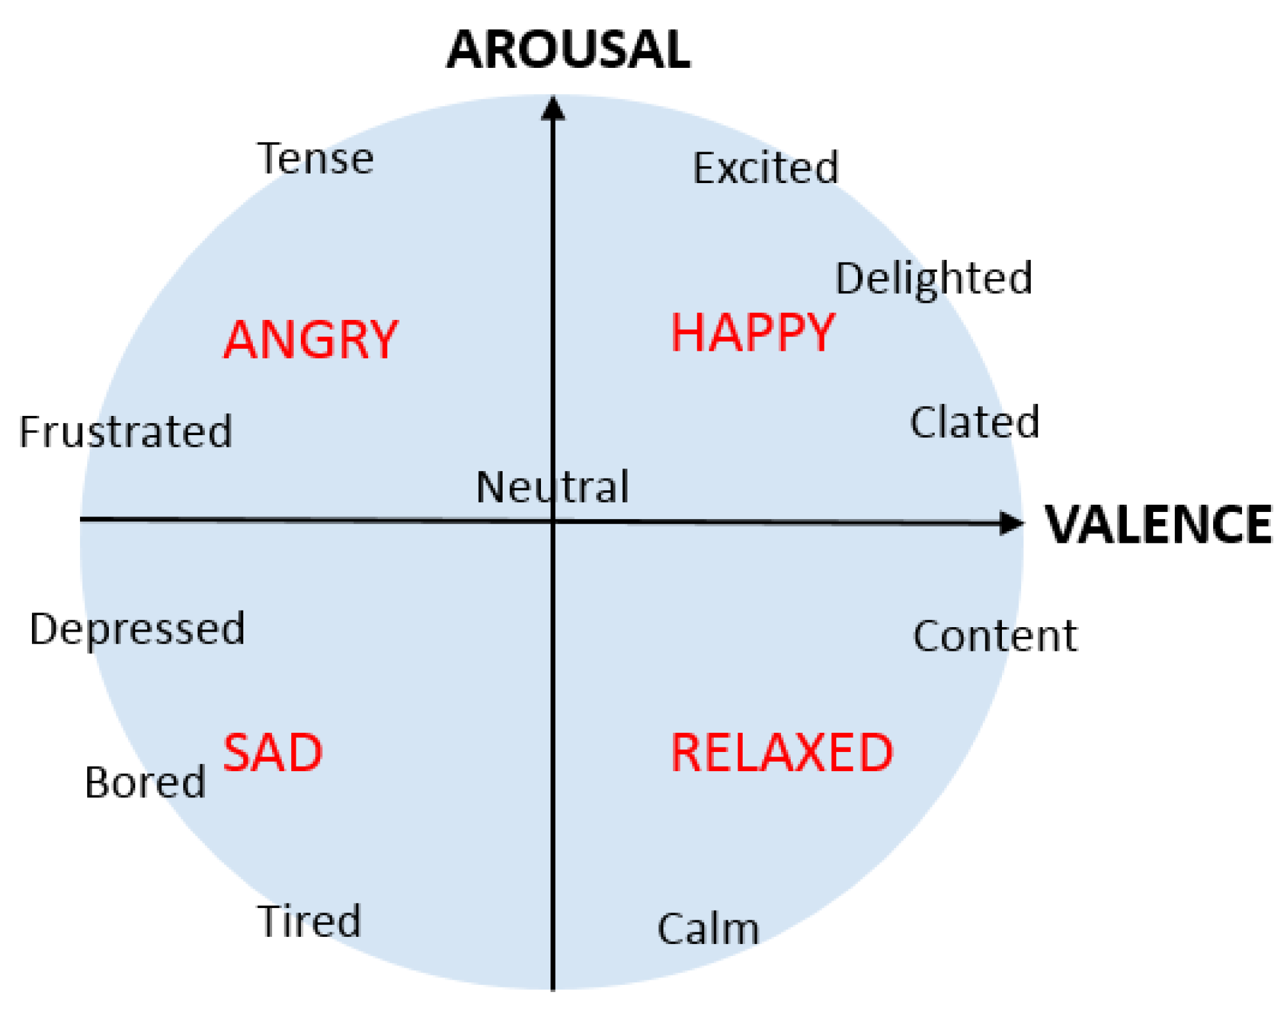
Introduction
Valence and Arousal
Emotional experiences can be described by two terms:
VALENCE: a scale that measures the positive or negative affectivity (so the pleasantness or unpleasantness of something)
AROUSAL: is a measure of how calming or exciting the information is

Slide 5




Implementation
In order to estimate valence and arousal on video events, first of all we generated the events starting from RGB videos
Then, we implemented a model which given an input video event, it returns an estimate of valence and arousal on this one
Main Implementation Tools
ESIM Simulator
Python
PyTorch framework
CUDA
TensorBoard

Slide 6
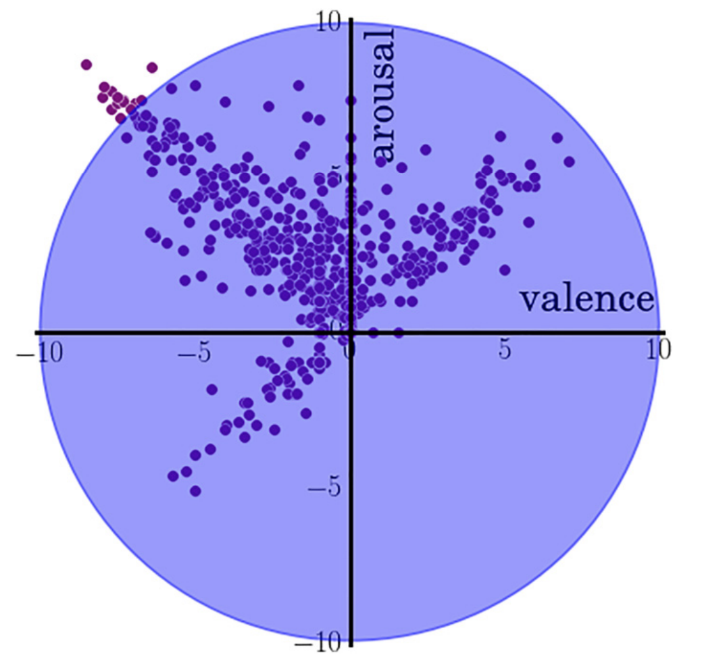
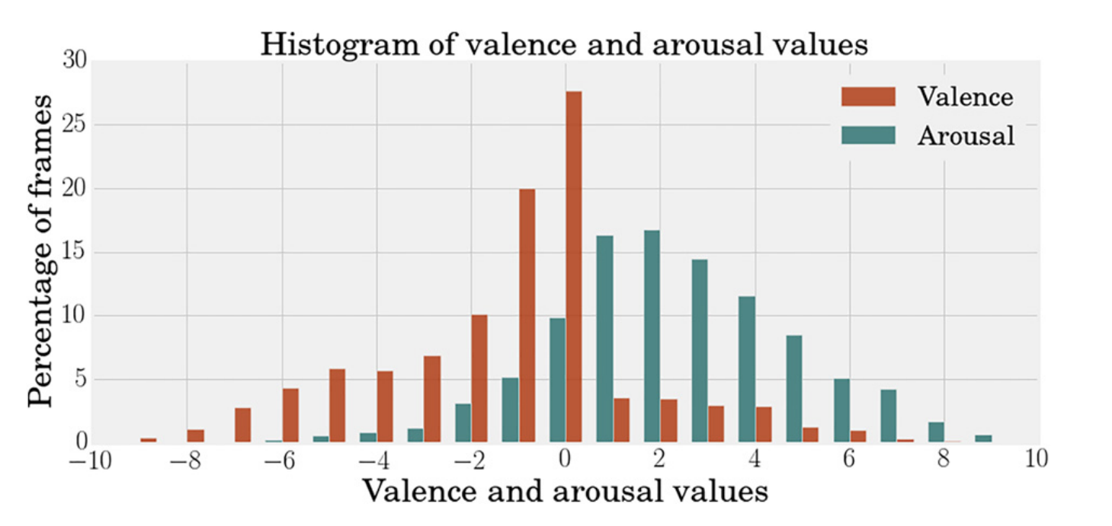
Implementation – Dataset
AFEW-VA Dataset
Collection of 600 RGB videos extracted from features films
Each video contains per-frame annotations levels of valence and arousal (which are discrete values in the range of -10 to 10), along with per-frame annotations of 68 facial landmarks.
Videos range from around 10 frames to longer clips (more than 120 frames); in total, there are 30,000 frames in the entire dataset

Slide 7

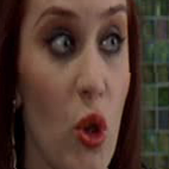
Implementation – Video Preprocessing
From RGB Videos to Video Events with ESIM Simulator
First of all, we cropped each frame of the RGB videos around the subject’s face (thanks to the facial landmarks provided by AFEW-VA dataset) to make them squared of size 200x200
After that, we also applied an image rotation on each cropped frame in order to make all the faces in the dataset oriented in the same way, i.e. faced to the camera
CROPPED AND ROTATED FRAME
ORIGINAL FRAME

Slide 8
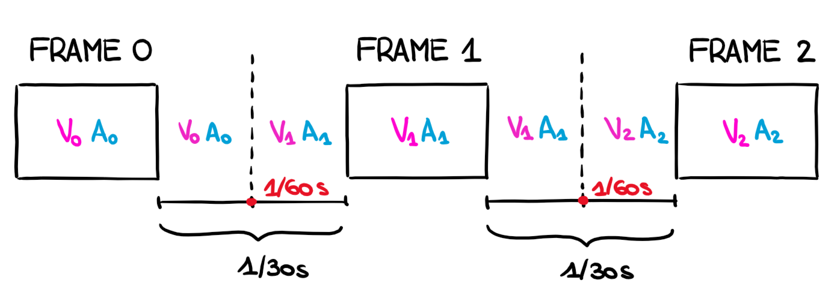
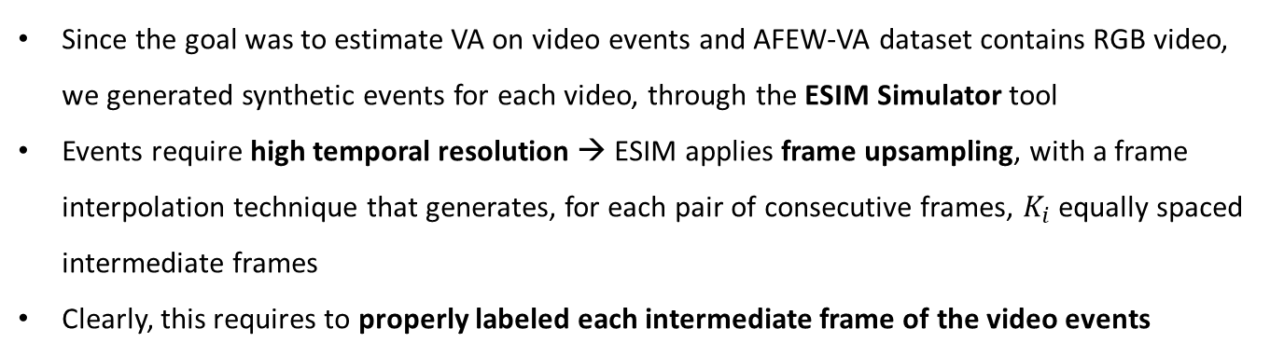
Implementation – Video Preprocessing
From RGB Videos to Video Events with ESIM Simulator
Since the goal was to estimate VA on video events and AFEW-VA dataset contains RGB video, we generated synthetic events for each video, through the ESIM Simulator tool
Events require high temporal resolution → ESIM applies frame upsampling, with a frame interpolation technique that generates, for each pair of consecutive frames, $K_{i}$ equally spaced intermediate frames
Clearly, this requires to properly labeled each intermediate frame of the video events

Slide 9
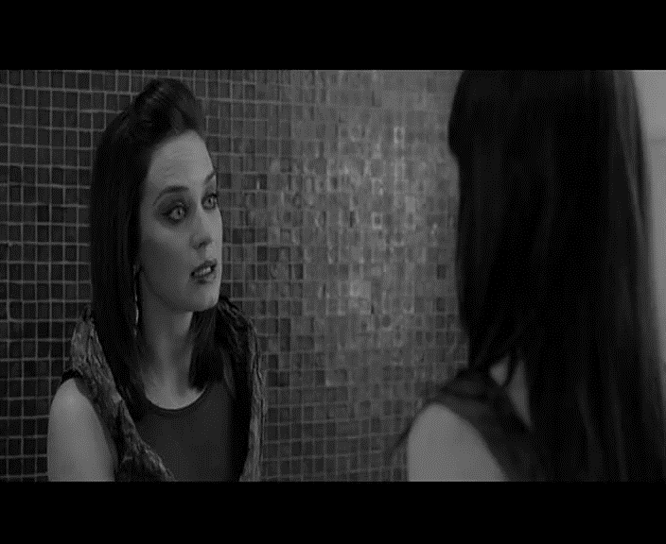
Implementation – Video Preprocessing
From RGB Videos to Video Events with ESIM Simulator
ORIGINAL RGB VIDEO
UPSAMPLED VIDEO

Slide 10
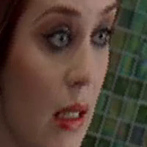
Implementation – Video Preprocessing
From RGB Videos to Video Events with ESIM Simulator
ORIGINAL RGB VIDEO
CROPPED AND ROTATED VIDEO

Slide 11
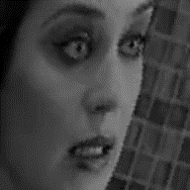
Implementation – Video Preprocessing
From RGB Videos to Video Events with ESIM Simulator
CROPPED AND ROTATED UPSAMPLED VIDEO
VIDEO EVENT

Slide 12
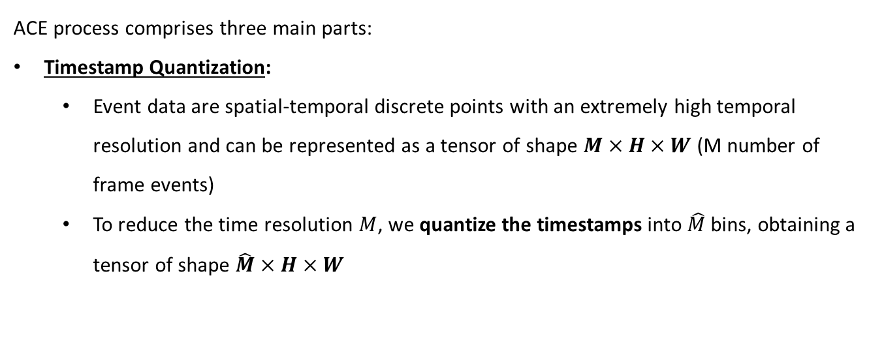

Implementation
Aligned Compressed Event
ACE process comprises three main parts:
Timestamp Quantization:
Event data are spatial-temporal discrete points with an extremely high temporal resolution and can be represented as a tensor of shape $M×H×W$ (M number of frame events)
To reduce the time resolution $M$, we quantize the timestamps into $\hat{M}$bins, obtaining a tensor of shape $\hat{M}×H×W$
$Q\left(T^{\left(i\right)}\right)=\max\left(\left\lceil \frac{\hat{M}×\left(T^{\left(i\right)}−\min\left(T\right)\right)}{\max\left(T\right)−\min\left(T\right)}\right\rceil , 1\right)$

Slide 13





Implementation
Aligned Compressed Event
Voxelization:
Past accumulative: for voxel at the $m_{th}$ bin, $y_{th}$ row and $x_{th}$ column, we sum the polarities for all past events on each pixel, formulated as
$$𝓥 \left(m,y,x\right)=\sum_{j=1}^{n}{𝕀\left(x_{j}=x, y_{j}=y, τ_{j}≤m\right)∙p_{j}}$$
Bin accumulative: for voxel at the $m_{th}$ bin, $y_{th}$ row and $x_{th}$ column, we sum the polarities for all events in the bin, as follow:
$$𝓥\left(t,m, y,x\right)=\sum_{j=1}^{n_{i}}{𝕀\left(x_{j}=x, y_{j}=y, { t≤τ}_{j}≤m\right)∙p_{j}}$$
Representative: for voxel at the $m_{th}$ bin, we choose a representative for the bin, i.e. the central frame event in the bin

Slide 14
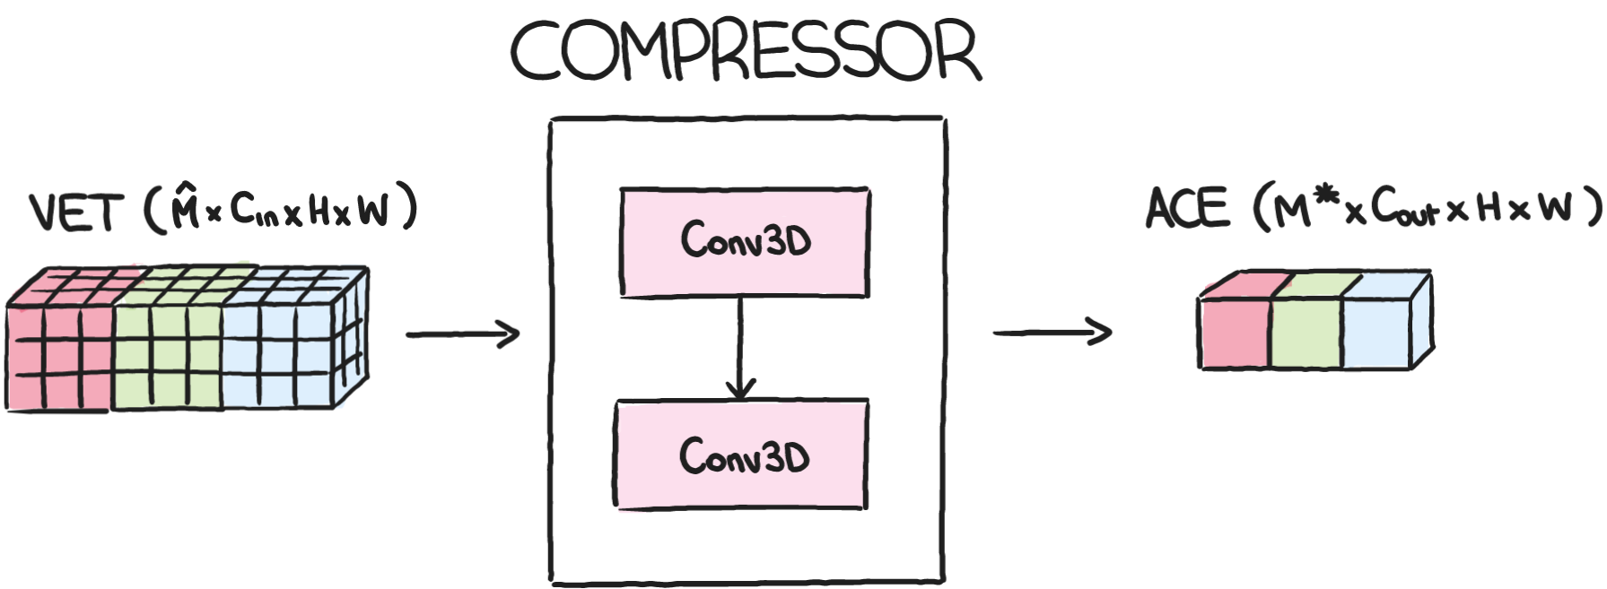
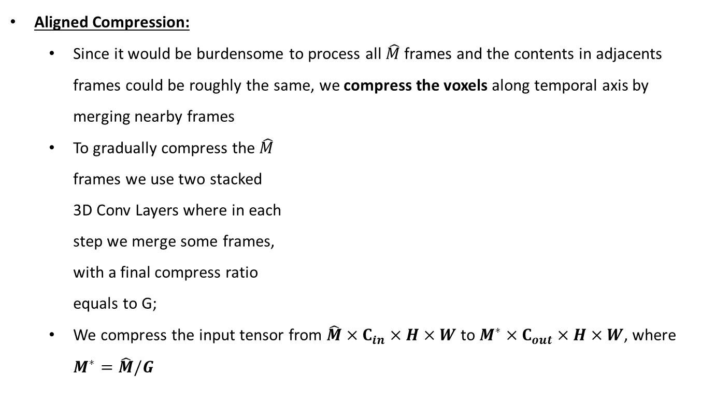
Implementation
Aligned Compressed Event
Aligned Compression:
Since it would be burdensome to process all $\hat{M}$ frames and the contents in adjacents frames could be roughly the same, we compress the voxels along temporal axis by merging nearby frames
To gradually compress the $\hat{M}$ frames we use two stacked 3D Conv Layers where in each step we merge some frames, with a final compress ratio equals to G;
We compress the input tensor from $\hat{M}×C_{in}×H×W$ to $M^{∗}×C_{out}×H×W$, where $M^{∗}=\hat{M}/G$

Slide 15
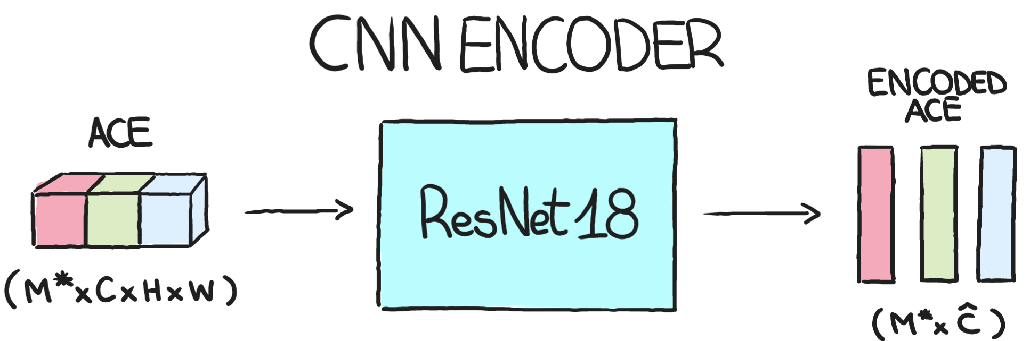
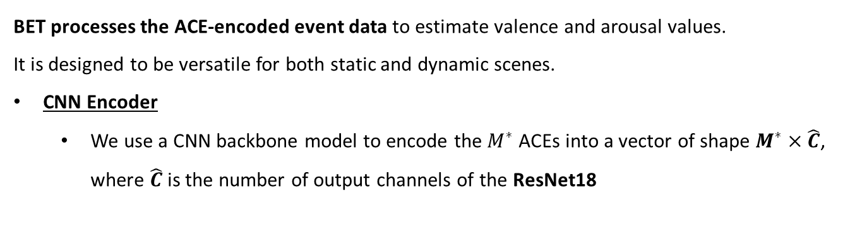
Implementation
Model Architecture – Branch Event Net
BET processes the ACE-encoded event data to estimate valence and arousal values. It is designed to be versatile for both static and dynamic scenes.
CNN Encoder
We use a CNN backbone model to encode the $M^{∗}$ACEs into a vector of shape $M^{∗}×\hat{C}$, where $\hat{C}$ is the number of output channels of the ResNet18

Slide 16
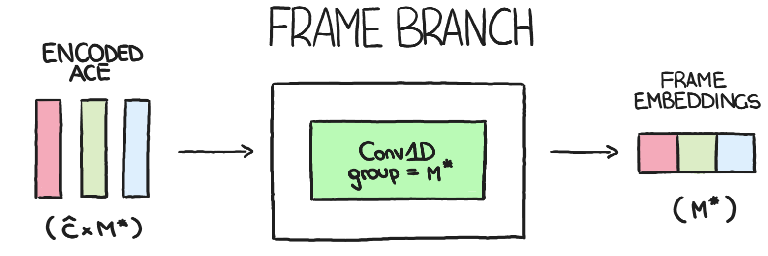
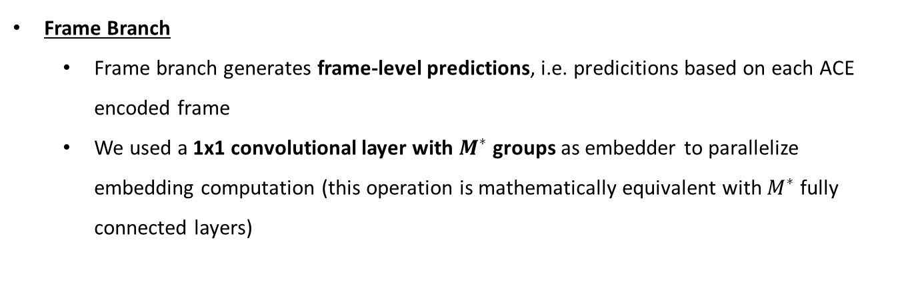
Implementation
Model Architecture – Branch Event Net
Frame Branch
Frame branch generates frame-level predictions, i.e. predicitions based on each ACE encoded frame
We used a 1x1 convolutional layer with $M^{∗}$groups as embedder to parallelize embedding computation (this operation is mathematically equivalent with $M^{∗}$fully connected layers)

Slide 17
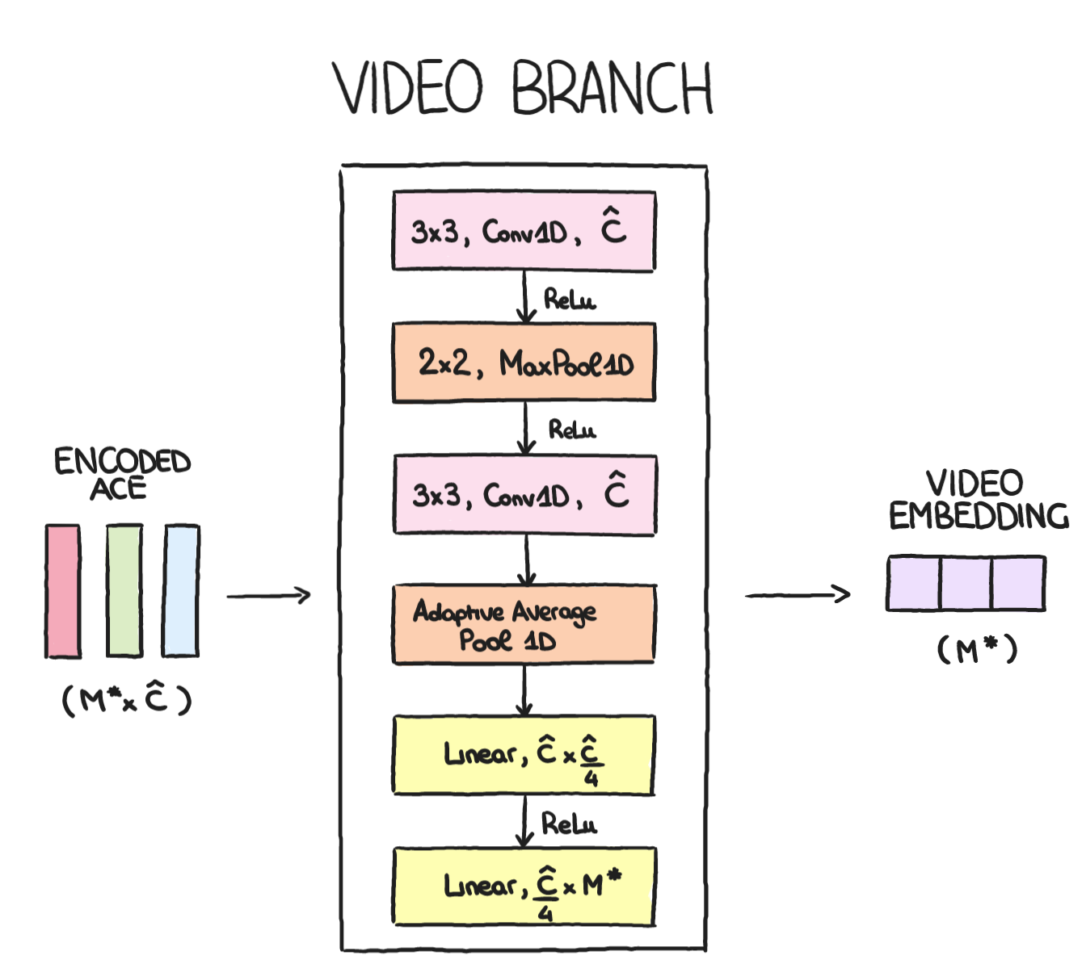
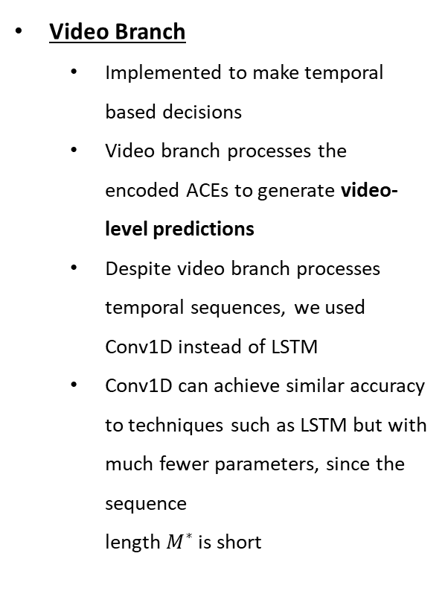
Implementation
Model Architecture – Branch Event Net
Video Branch
Implemented to make temporal based decisions
Video branch processes the encoded ACEs to generate video-level predictions
Despite video branch processes temporal sequences, we used Conv1D instead of LSTM
Conv1D can achieve similar accuracy to techniques such as LSTM but with much fewer parameters, since the sequence length $M^{∗}$is short

Slide 18
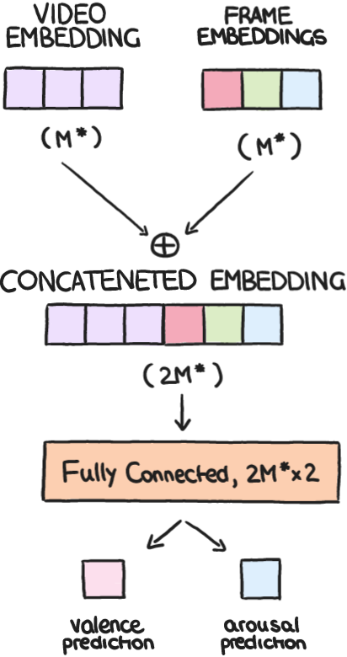
Implementation
Model Architecture – Branch Event Net
Result synthesis
To merge the predictions obtained from the two branches, we simply concateneted them and given as input to a fully connected layer
The fully connected layer implements a regression to estimate valence and arousal

Slide 19
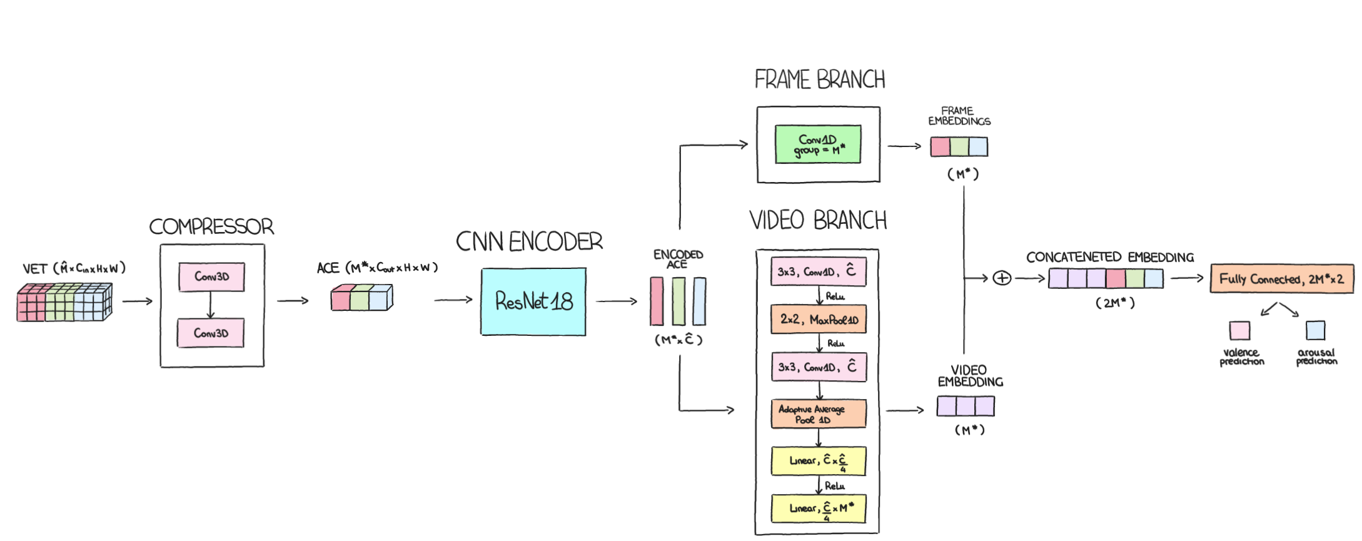
Implementation
Model Architecture – Branch Event Net

Slide 20
Experiments and Results
Dataset preparation
RAW DATASET: half of AFEW-VA dataset (300 RGB videos in total) for memory issues
EVENT DATASET: generation of events from the raw dataset, splitted in 80% for training and 20% for testing
Data augmentation: we considered a 0.5s sliding window with a 8/30 s of stride, to divide video events into chunks (dataset augmented of a factor 3), where each chunk is labeled with valence and arousal values of its last frame
CHUNKED DATASET: after data augmentation we obtained 883 examples for the training and 206 examples for testing
Scaling of labels: we scaled labels (which originally was in range -10 to 10) to be [-1 ; 1]
Data standardization: we calculate mean and standard deviation from training data to standardize all the dataset

Slide 21
Experiments and Results
Executed on computer with the following specifics:
OS: Microsoft Windows 10 Pro
CPU: 11° Gen Intel(R) Core(TM) i9-11900KF @3.5GHz(TBoost 5.1GHz) Octa-Core
GPU: GeForce RTX 3070Ti
RAM: 32GB DDR4 @3600 MHz
MOBO: Asus PRIME Z490-A
Training configuration
Dataset: chunked dataset
Epochs: 100
Batch size: 32
Optimizer: AdamW (with 0.001 of learning rate)
Criterion: BETLoss (which combine the independent losses of valence and arousal), i.e. BETLoss = α*valence loss + β*arousal loss

Slide 22
Experiments and Results
BETLoss: RMSE (Root-Mean-Square Error)
Three experiments using BETLoss equipped with the RMSE Loss:
With representative voxelization
With bin accumulative voxelization
With past accumulative voxelization

Slide 23
Experiments and Results
BETLoss: WMSE (Weighted-Mean-Square Error)
Since the distribution of the data in AFEW-VA is very unbalanced, we equipped the BETLoss with a weighted MSE Loss that gives to each example a weight which is the inverse of the frequency of its class
Three experiments:
With representative voxelization
With bin accumulative voxelization
With past accumulative voxelization

Slide 24
Experiments and Results
No voxel accumulation with RMSE as criterion
Add a Triplet Loss as criterion during the training

Slide 25
Experiments and Results
No voxel accumulation with RMSE as criterion
Add a Binary Cross Entropy as criterion during the training

Slide 26
Experiments and Results
No voxel accumulation with RMSE as criterion
Add a Triplet Loss and Binary Cross Entropy as criterion during the training

Slide 27
Experiments and Results
Bin-level voxel accumulation with WMSE as criterion
Add a Triplet Loss as criterion during the training

Slide 28
Experiments and Results
Bin-level voxel accumulation with WMSE as criterion
Add a Binary Cross Entropy as criterion during the training

Slide 29
Experiments and Results
Bin-level voxel accumulation with WMSE as criterion
Add a Triplet Loss and Binary Cross Entropy as criterion during the training

Slide 30
Experiments and Results
Comparison
 | Only base criterion | With the addition of triplet loss | With the addition of BCE | With the addition of both triplet and BCE
RMSE (no voxel accumulation)
WMSE (bin-level voxel accumulation)

Slide 31
Qualitative Results

Slide 32
Conclusions

Slide 33
Valence and Arousal
Estimation for Video Events
Giulia Bertazzini
Niccolò Guiducci
Firenze, 7 Aprile 2023

Slide 34
